Slide 1
Choosing New Bar Location Using Foursquare
Matt Spees

Slide 2
Background
Client wants to start a new bar in Toronto city
Bars and similar venues are a very competitive market
Location based on competitors extremely important to success
Foursquare has location and characteristics for venues mainly for consumers to find new places near them

Slide 3
Data
Venue, location, and neighborhood were all extracted and scraped from Foursquare using developer API
All data was inserted into a data frame and grouped by neighborhood which in total included 38 neighborhoods
Neighborhoods were later separated via k-means clustering

Slide 4
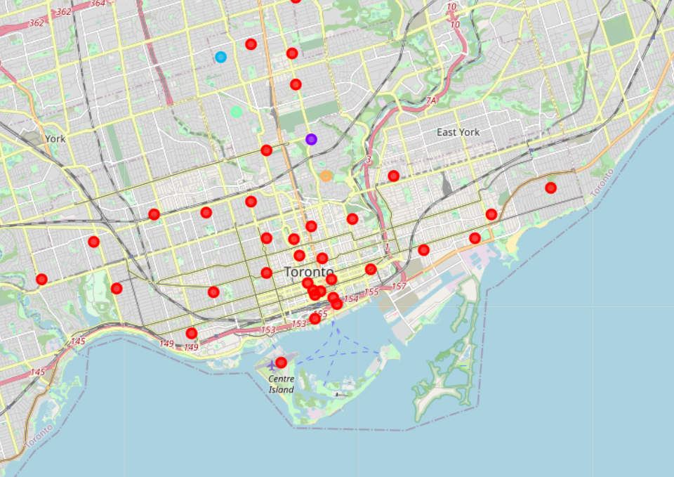
Toronto Neighborhoods with Clusters

Slide 5
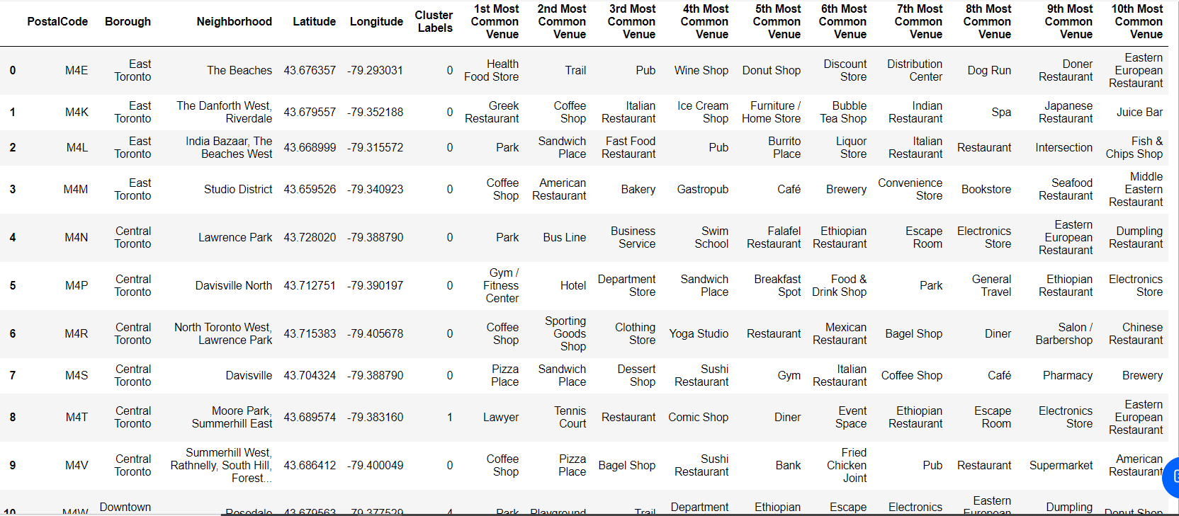
Data Frame

Slide 6
Conclusion
Based on map and data frame, Brockton, Parkdale Village and Runnymede, Swansea are the two neighborhoods to start a bar venue
Both locations have bars as 10th most common venue
Future analyses could see more viability of bars using likes system within Foursquare

